Slide 1
What’s new in F# 6
Kathleen Dollard
@KathleenDollard

Slide 2
Introduction
F# is succinct, robust, performant
It’s still functional, it’s also “functions and data” and OOP
Why I love F#
A look at F# 5 highlights
A look at F# 6 highlights

Slide 3
“Succinct, robust, performant” articulates what F# already was
Succinctness | Type inference Expression-oriented Tuples Active patterns ….
Robustness | Strongly typed No-nulls Functional abstraction …
Performance | Typed code Generics without boxing ….
Expressiveness | …
Interoperable | …
Functional | …

Slide 4
And also…
F# is natural for simple coding with functions and data style
F# has good OOP support
F# remains true to its functional roots
F# is expression based; defaults to immutable no nulls
F# has great features like discriminated unions and active patterns
F# is a full citizen in .NET Interactive and has its own interactive (FSI)
F# is great for DSLs and DSL-like coding
Fable is a JavaScript transpiler using the F# language
F# has the full power of .NET and C#/VB interop

Slide 5
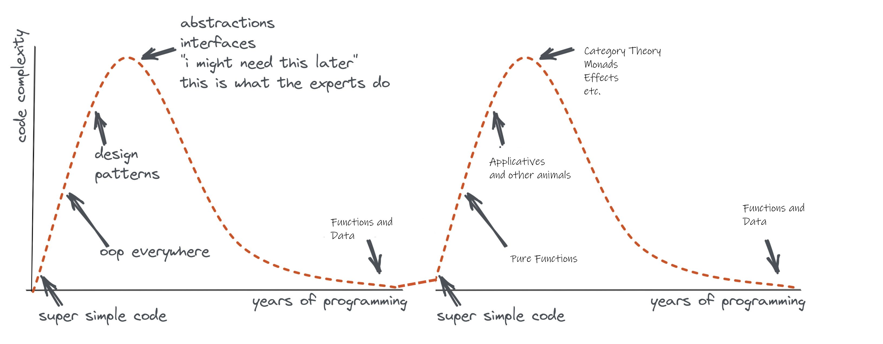
Remember the eternal sweet spot of programming! Functions + Data + Types

Slide 6

Why I love F#
Demo

Slide 7

Why I love F#
Demo

Slide 8
F# 5! Release Nov 2020

Slide 9

F# 5 (cause we missed last year)
Demo

Slide 10

F# 5 (cause we missed last year)
Demo

Slide 11
F# 5 - Laundry list
FSharp.Core targets netstandard2.0
#r "nuget: …“
.NET Interactive
String interpolation
nameof
open type
Slicing updates
Applicatives
Stack traces for async
Multi generic instantiations
Default interface member consumption
Interop with nullable value types
Improved Map/Set performance
Improved Compiler performance
Checked XML docs

Slide 12
F# 6! Release Nov 2021

Slide 13
F# 6 - Laundry list
Faster
task { … } and resumable code
Structs for partial active pattern returns
InlineIfLambda
4x perf for list and array expressions
Simpler
expr[idx]
Additional implicit conversions
New methods on immutable collections
Keys and Values for map
NativePtr intrinsics
Better tooling
Pipeline debugging
Value shadowing
Tooling perf, scalability (64-bit, multi-thread)
More consistent
Overloaded and params custom operations in computation expressions
“as” patterns
Indentation syntax revisions
Discards on use bindings
Formatting binary numbers
More types for units of measure
Better scripting
Scripting respects global.json
.NET Core default for VS scripting
Clean up
Remove legacy features
! and := soft deprecation

Slide 14


F# 6
Demo

Slide 15
F# 6 - Laundry list
Faster
task { … } and resumable code
Structs for partial active pattern returns
InlineIfLambda
4x perf for list and array expressions
Simpler
expr[idx]
Additional implicit conversions
New methods on collections
Keys and Values for map
NativePtr intrinsics
Better tooling
Pipeline debugging
Value shadowing
Tooling perf, scalability (64-bit, multi-thread)

Slide 16
task{..} an async{..}
task{..} advantages
Better performance
Better stepping and stack traces for task {…} debugging
Better interop with .NET packages expecting or producing tasks
Some differences to be aware of
task {…} immediately executes the task to the first asynchronous yield
task {…} does not implicitly propagate a cancellation token
task {…} does not perform implicit cancellation checks
task {…} does not support asynchronous tailcalls

Slide 17
F# 6 - Laundry list
More consistent
Overloaded and params custom operations in computation expressions
“as” patterns
Indentation syntax revisions
Discards on use bindings
Formatting binary numbers
More types for units of measure
Better scripting
Scripting respects global.json
.NET Core default for VS scripting
Clean up
Remove legacy features
! and := soft deprecation

Slide 18
F# 6 - Laundry list
task { … }
Resumable code
expr[idx]
Structs for partial active pattern returns
Overloaded custom operations in CEs
“as” patterns
Indentation syntax revisions
InlineIfLambda
4x perf for list and array expressions
Additional implicit conversions
Immutable collection updates
More unit annotations
! and := soft deprecation
Remove legacy features
Pipeline debugging
Value shadowing
Tooling perf, scalability (64-bit, multi-thread)
.NET Core default for VS scripting
Scripting respects global.json
General improvements in .NET 6
General improvements in Visual Studio 2022

Slide 19
Review
F# continues to evolve to become succinct, robust and performant
Highlights of F# 6
Task
New methods
Better debugging (pipeline debugging FTW!)
Faster

Slide 20

Huge thank you to contributors
Thank you!
Don’t forget to complete an online evaluation
What’s new in F# 6
@KatheenDollard
https://devblogs.microsoft.com/dotnet/whats-new-in-fsharp-6/#thanks-and-acknowledgments

Slide 22
String interpolation
The very first F# RFC FS-1001, from 2014
Design has been iterated, very happy with the result
Why?
Improved readability
Reduced errors
More succinct
Less to learn
Aim
Align with C#
But keep strong typing by unifying with printfn
Allow use with printfn + friends
Demo

Slide 23
“open type”
RFC FS-1068
Increase expressivity of F# DSLs and ultra-succinct mode programming
Single-word “functions” can be overloaded members accepting named, optional, ParamArray arguments
Demo
Caveat emptor. Don’t inflict this on yourself or your friends without real thought about ramifications

Slide 24
#r "nuget: …"
People rate this as the #1 feature for Python programmers
Combined with global.json in script directory allows you to “lock down” F# scripts as trustworthy
#r "nuget: Newtonsoft.Json“
#r "nuget: Newtonsoft.Json, 11.0.1"
#i "nuget: https://my-remote-package-source/index.json"

Slide 25
Applicatives
RFC FS-1063
Directly from the last F# London meetup ☺
Applicatives are often two-phased computations
Separate “compose” from “run”
Static “composition”, then dynamic “run”
Example: graphs of fixed size (pre-allocate buffers, then run)
Example: validation (compose validators, then run)
For F#, this means “let! … and! …” in computations
Maps to overloaded BindReturn/MergeSources
See RFC
Demo

Slide 26
expr[idx]
Why?
We lose people for no reason
“Making F# better by moving it towards it already was”
Demo
Caveats

Slide 27
task { .. }
Why, what
Demo
Differences with async
A task is a single mutable, awaitable register
Hot start
No implicit cancellation checks
No implicit cancellation propagation
No tailcalls (to discuss…)
Use primarily for interop when heavily consuming or producing tasks
Debugging can be better
Builds on “resumable code”, has other applications

Slide 28
!, :=, incr, decr soft deprecation
RFC FS-1111
These operators are highly confusing to beginners
They are now rarely used
Soft deprecation via informational messages
Demo

Slide 29
Performance and Scalability
F# Compiler Service new multi-threaded (no reactor queue!)
Makes IDEs MUCH more responsive
Visual Studio 2022 now 64-bit
Other major performance improvements, see announcements

Slide 30
Pipeline Debugging!
Demo
Also shadowing on values shown in debugging

Slide 31
Performance for [ ..] and [| … |]
Demo/link

Slide 32
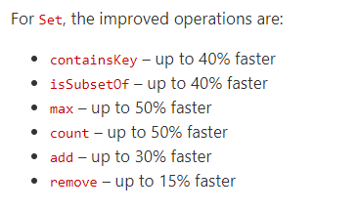
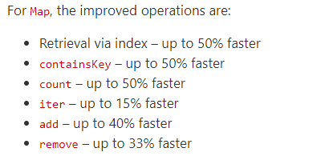
Improved Map/Set performance
By Victor Baybekov
In FSharp.Core 5.0.0+

Slide 33
Doc improvements
XML Doc checking!
FSharp.Core examples! (500)
docs.microsoft.com/dotnet/fsharp/ revamp!
Call to action. Stackoverflow is becoming a problem for us. Please update your answers!

Slide 34





